Slide 1

contact@softyeducation.com

Slide 2
Day 2

Slide 3
Content :
Variables
Data Types
Control Flow
Loops
Functions
Exercises

Slide 4
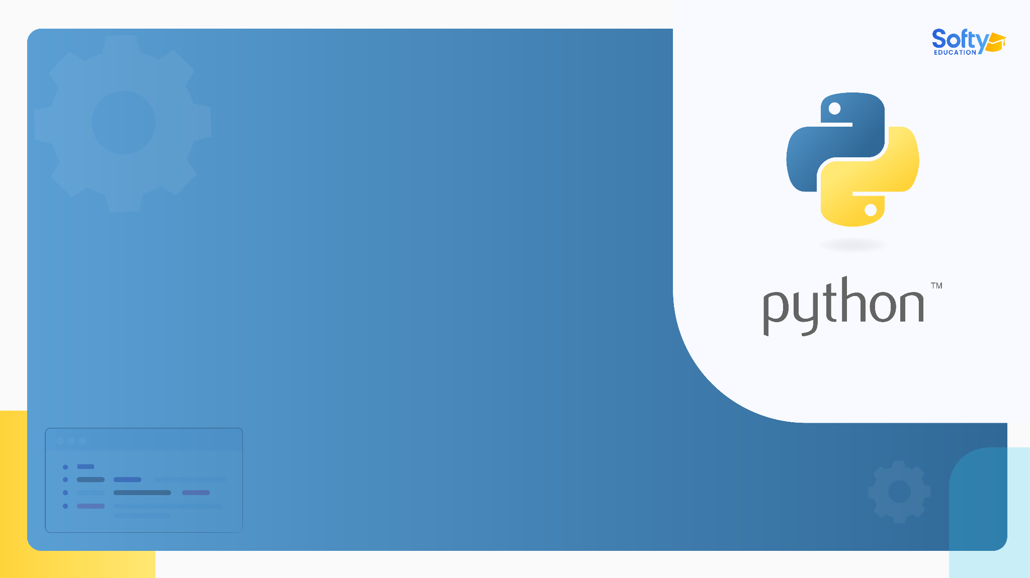
01
Variables

Slide 5

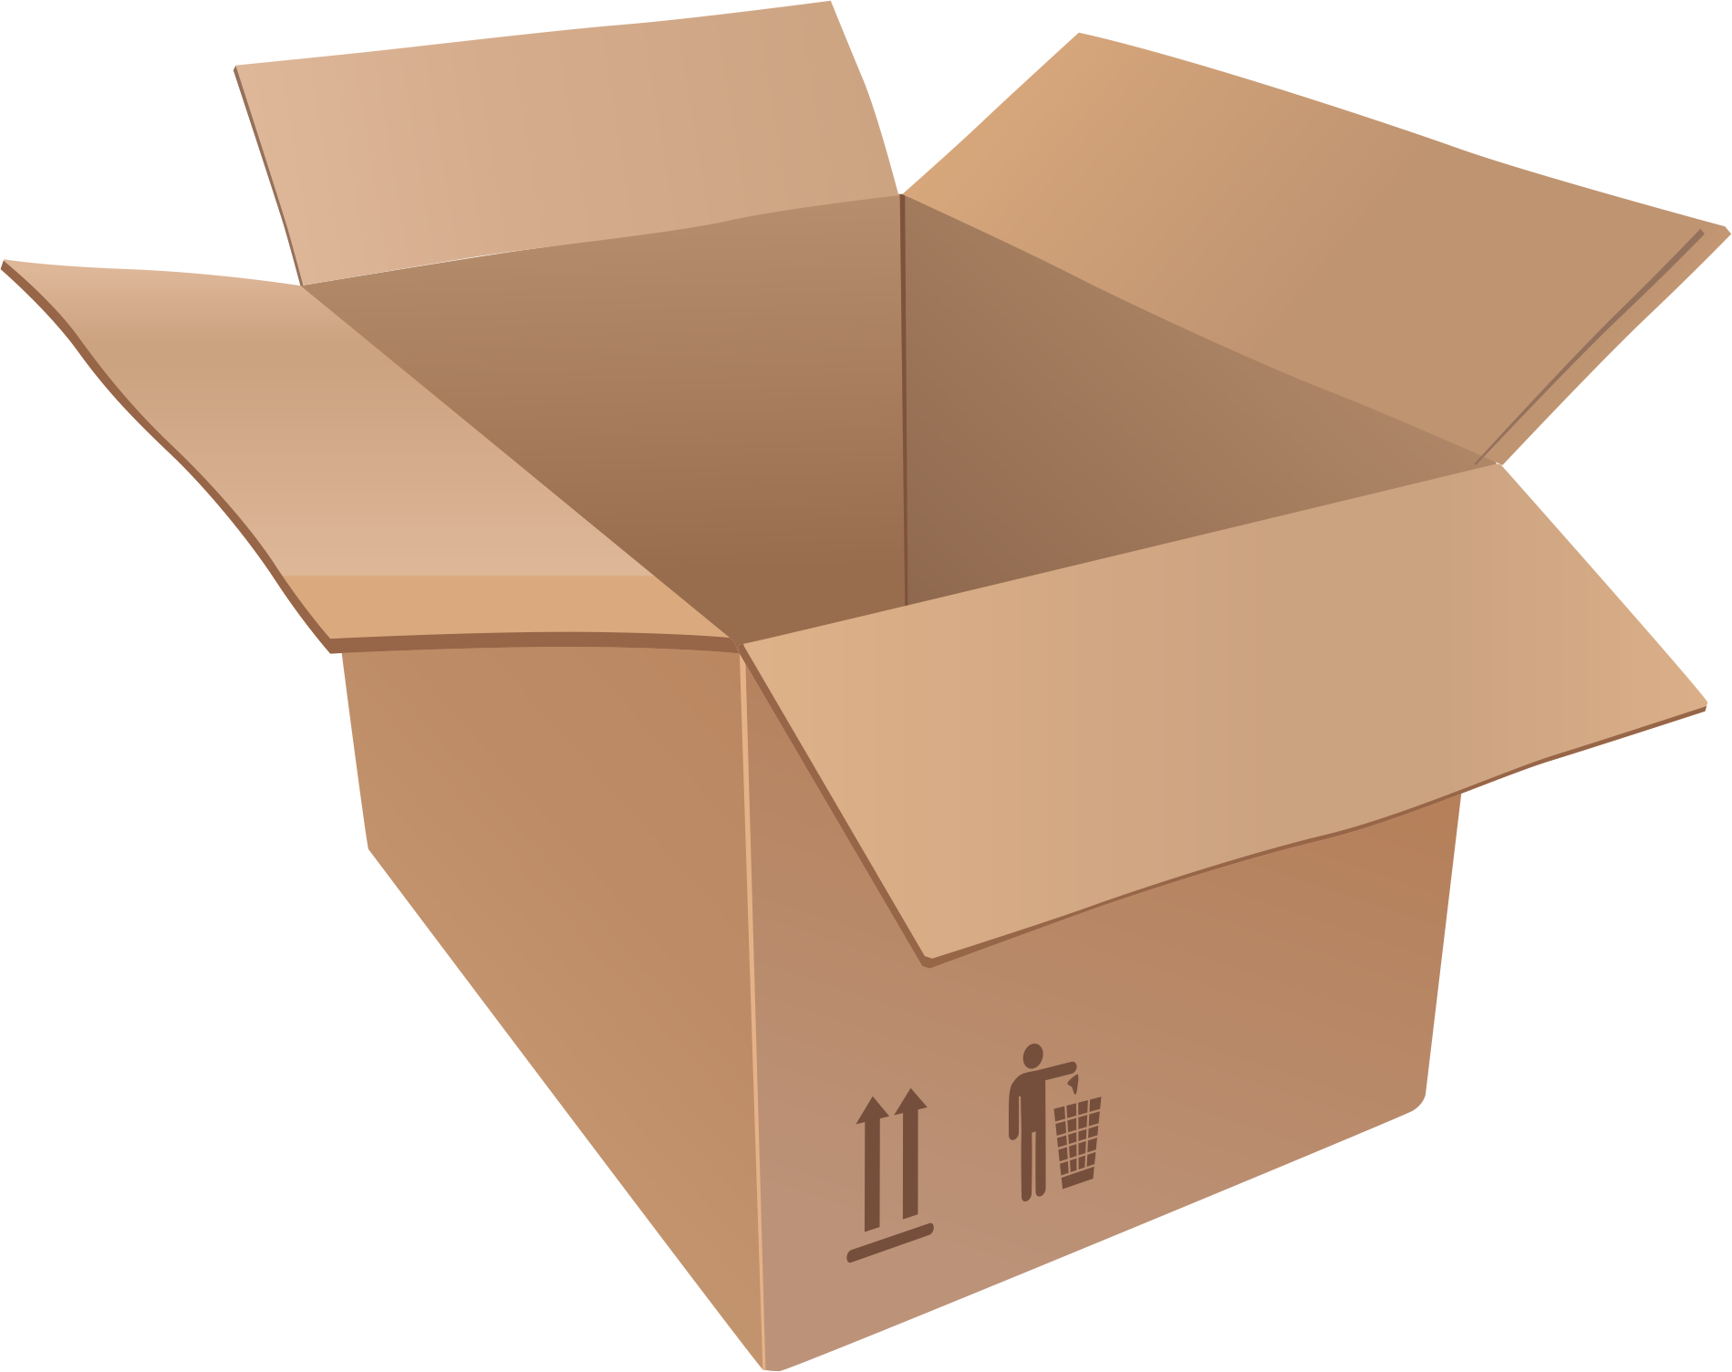
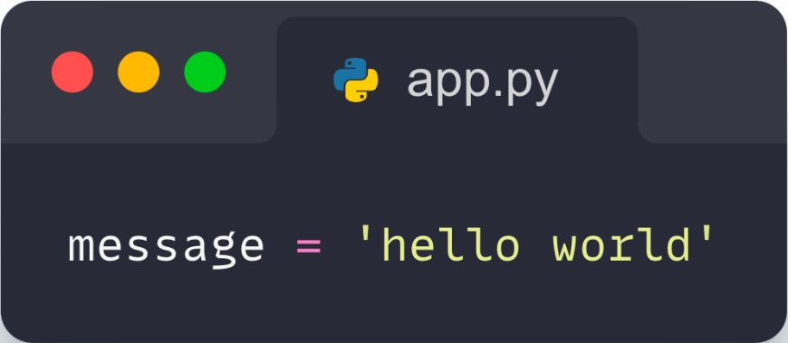
01- Variables
The variable is like the box where we store our things .
Example :
Variable
‹#›
The content of the variable

Slide 6
02
Data Types

Slide 7
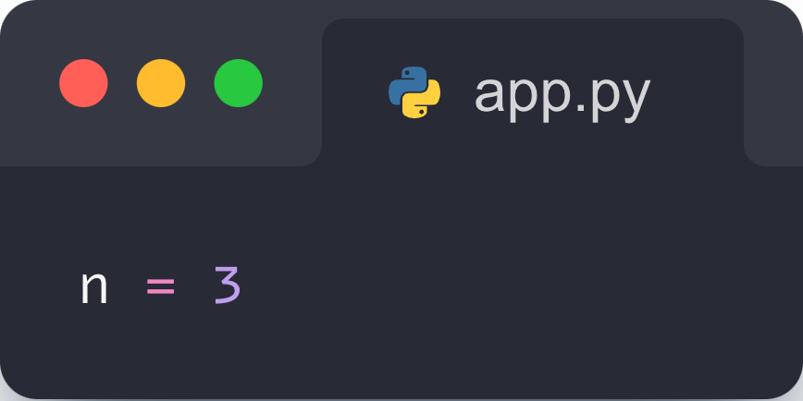
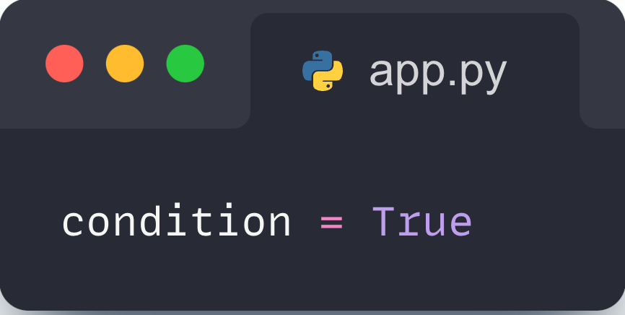

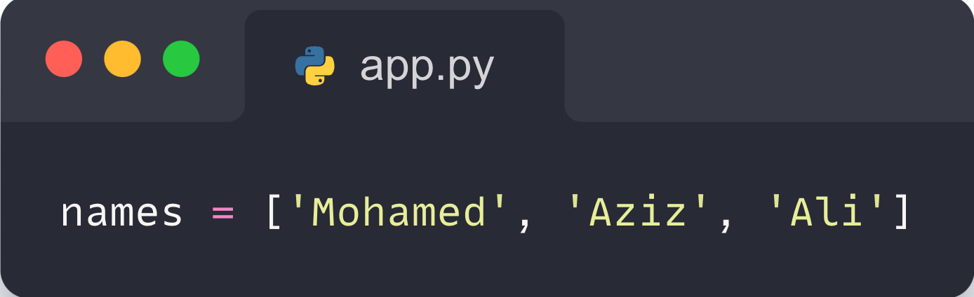
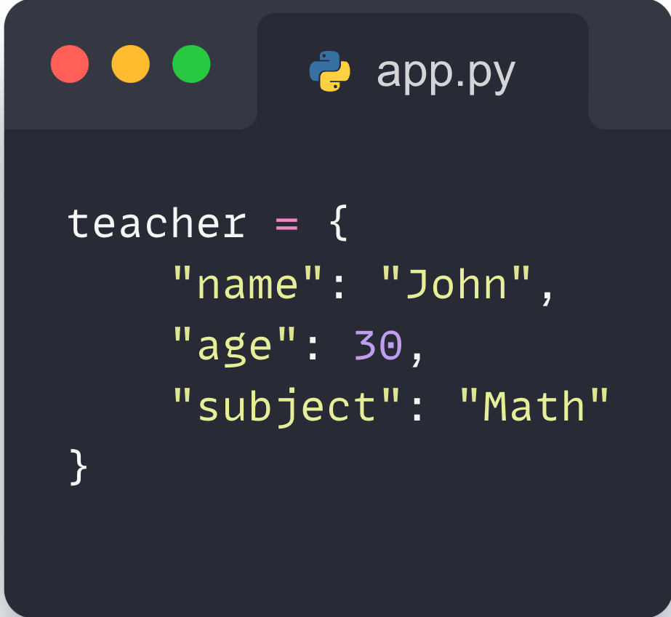
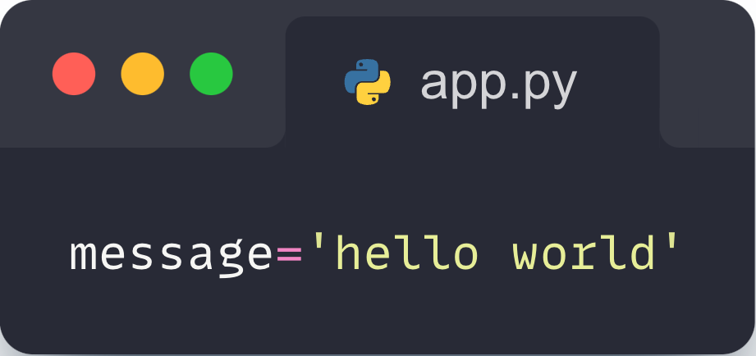
02- Data Types
Python has several data-types :
Type Int :
Type Boolean :
Type Float :
Type List :
Type String :
Type Dict :
‹#›

Slide 8
03
Control Flow

Slide 9
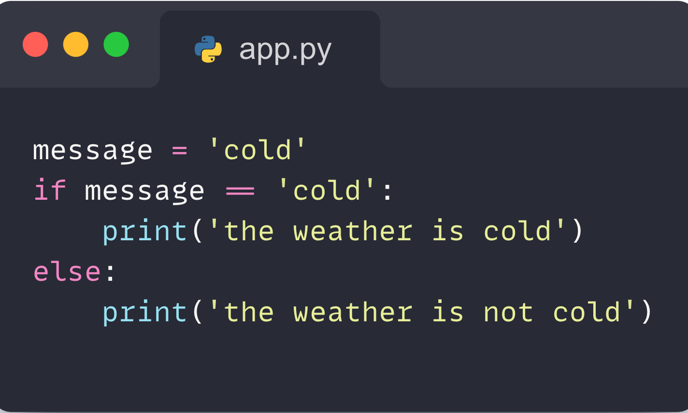
03- Control Flow
The control flow is a path to walk through if a certain condition is verified .
In Python, The control flow is based on if, else statements .
‹#›

Slide 10
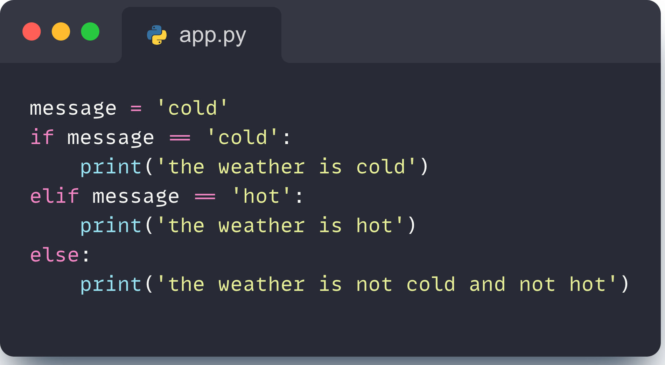
03- Control Flow
Another Example :
‹#›

Slide 11
04
Loops

Slide 12
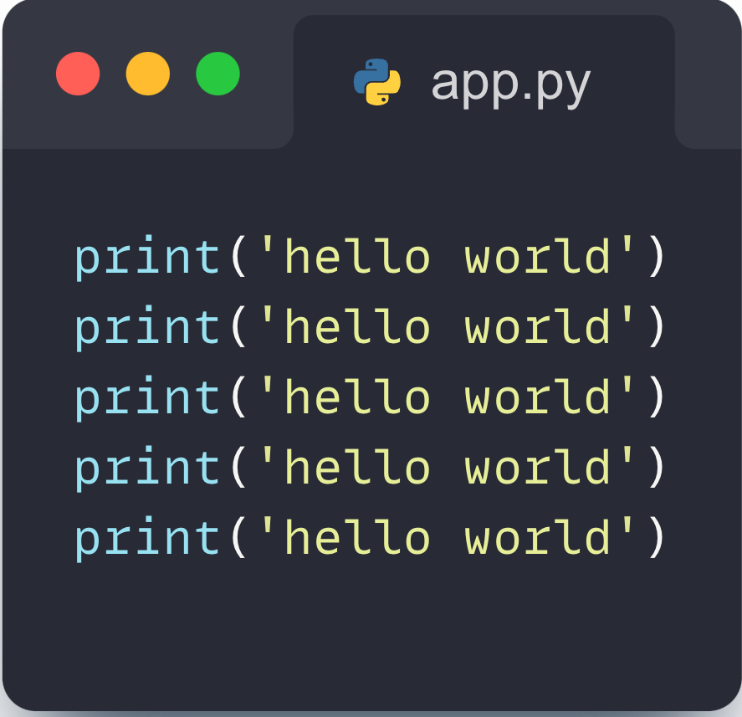
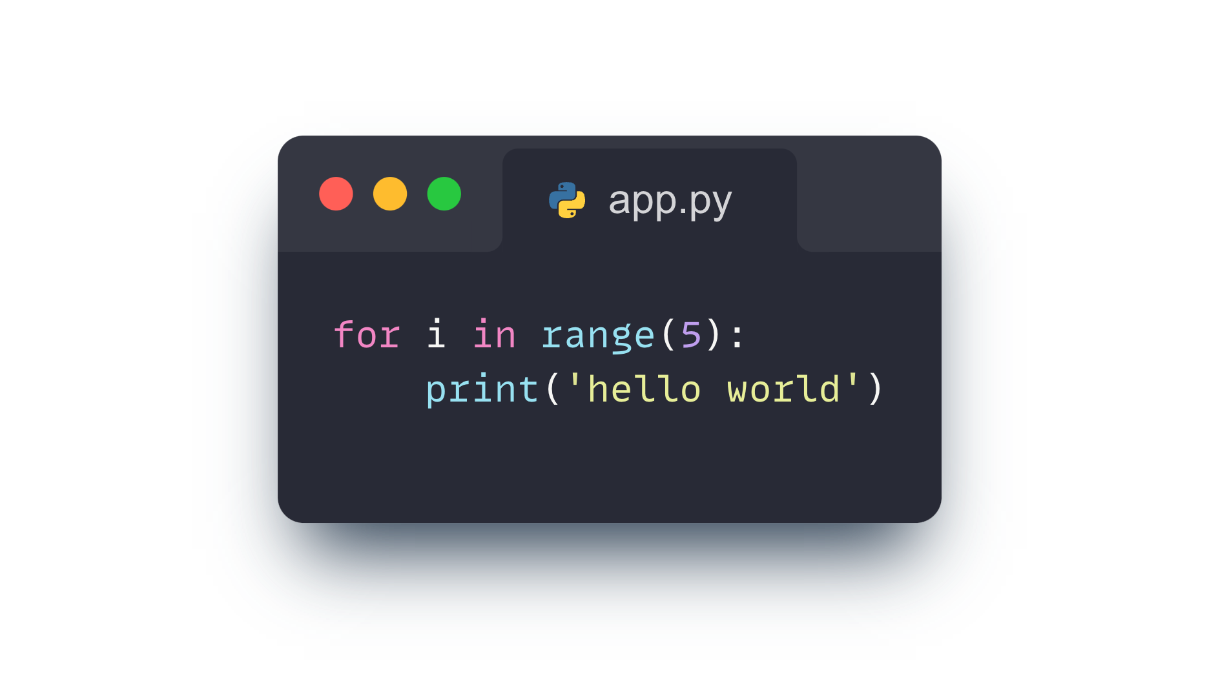
04- Loops
When I have to do a thing many times, like print ‘hello world’ 5 times , instead of doing that manually I use a loop :
‹#›

Slide 13
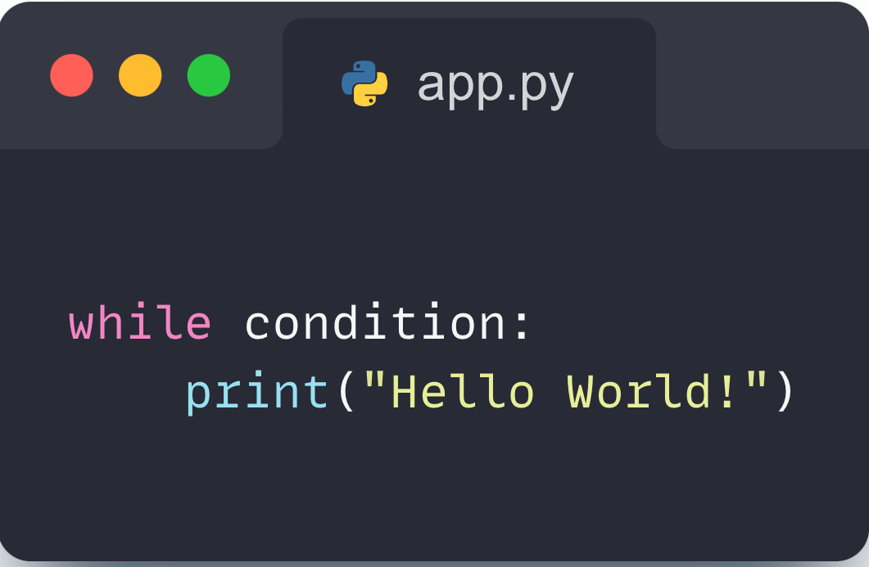
04- Loops
In Python we have 2 types of loops :
‹#›

Slide 14
04- Loops
When to use for loop and When to use while loop :
When to the number of repetition is known example 4, 5, 10 we use for loop :
‹#›

Slide 15
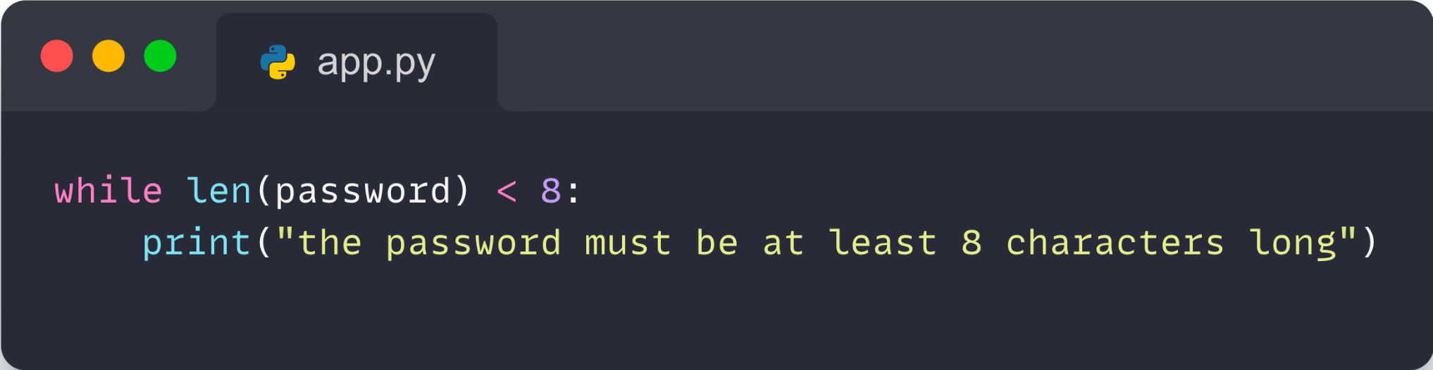
04- Loops
When to the number of repetition is unKnown we use while loop :
Example : we use the while loop if we need the user to enter a password greater than 8 characters , because we don’t know when the user will verify this condition .
‹#›

Slide 16
05
Functions

Slide 17
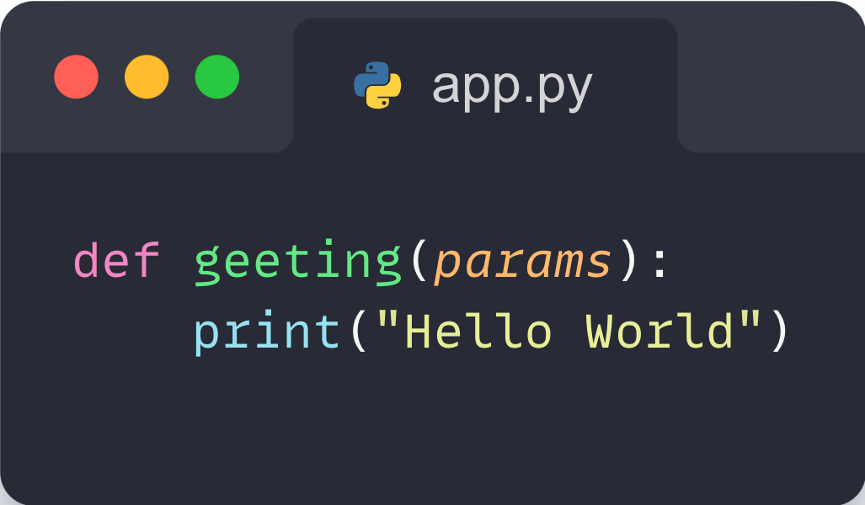
05- Functions
A function is a set of instructions that are grouped together and can be reused .
Name of the function
Parameters that can be used within the function
Keyword of declaration of a function
instructions
‹#›

Slide 18
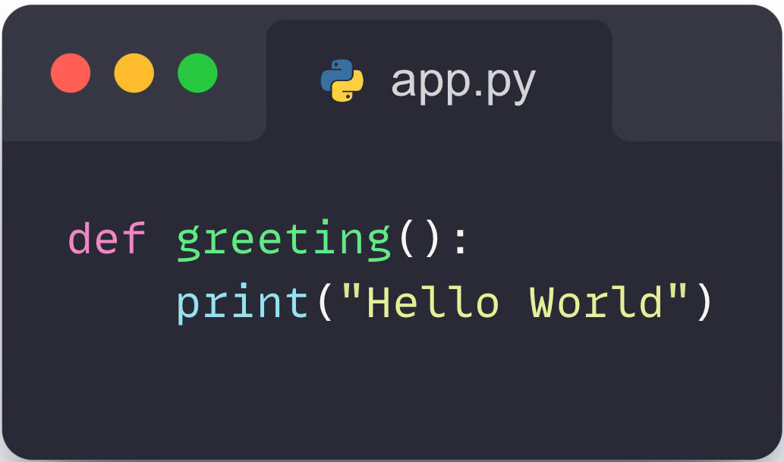
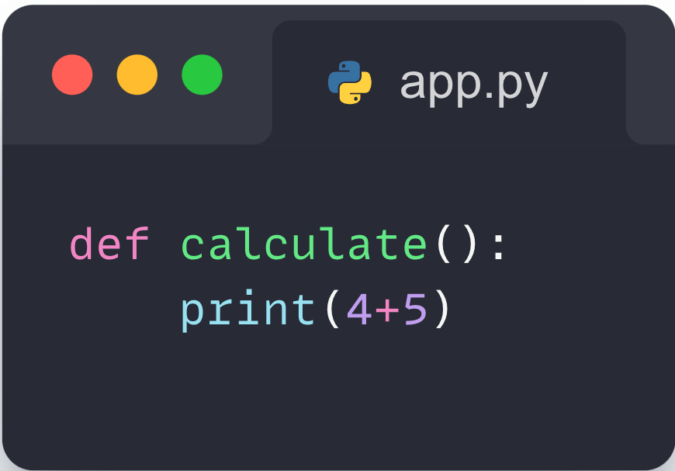
05- Functions
Examples :
‹#›

Slide 19
06
Exercises

Slide 20
04- Exercises
Variables
Exercise 1.1: Create two variables a and b, assign them different numerical values, and print their sum.
Exercise 1.2: Create a variable name and assign your name to it. Print a greeting using this variable.
Exercise 1.3: Swap the values of two variables x and y without using a third variable, then print the values of x and y.
‹#›

Slide 21
04- Exercises
Data Types
Exercise 2.1: Create variables of each type: integer, float, string, boolean, and list. Print the type of each variable.
Exercise 2.2: Create a list of five elements, and print the first and last element.
Exercise 2.3: Concatenate two strings together, and print the result.
‹#›

Slide 22
04- Exercises
Control Flow
Exercise 3.1: Write a program that takes an input number from the user and prints whether it's positive, negative, or zero.
Exercise 3.2: Write a program that takes a grade from the user and prints whether it's an bad, average, or good.
Exercise 3.3: Write a program that takes the age of the user and prints whether they are eligible to vote (assuming the voting age is 18).
‹#›

Slide 23
04- Exercises
Loops
Exercise 4.1: Write a program that prints the numbers 1 to 10 using a for loop.
Exercise 4.2: Write a program that takes a number n from the user and prints the sum of numbers from 1 to n using a while loop.
Exercise 4.3: Write a program that prints the multiplication table of a given number using a loop.
‹#›

Slide 24
04- Exercises
Functions
Exercise 5.1: Write a function that takes two numbers and returns their sum.
Exercise 5.2: Write a function that takes a radius and returns the area of a circle with that radius.
Exercise 5.3: Write a function that takes a string and returns the number of vowels in that string.
‹#›

Slide 25
Thank you

